Slide 1
HOTEL RESERVATION ANALYSIS WITH SQL
BY KINGS BLESSING DIANE

Slide 2
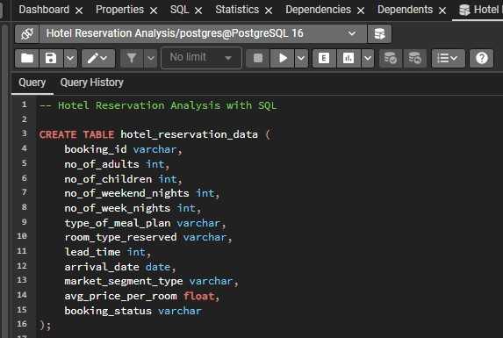
APPROACH
To query and analyze the data, I made use of PostgreSQL.
The first step I carried out was to create a database called ‘Hotel Reservation Analysis”
Next, I created a table for the dataset in PostgreSQL, and imported the dataset.
Next, I went to analyzing the dataset and writing SQL queries to answer the mentioned questions.

Slide 3
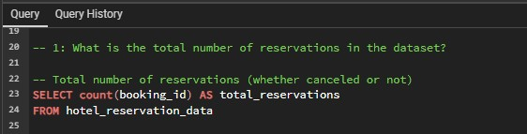
QUESTION 1: What is the total number of reservations in the dataset?
To find total number of reservations, count of the booking_id column was selected. This will show the total number of reservations whether canceled or not.

Slide 4
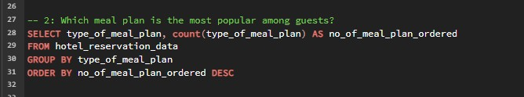

QUESTION 3: What is the average price per room for reservations involving children?
QUESTION 2: Which meal plan is the most popular among guests?
type_of_meal_plan and count of type_of_meal_plan was selected.
The selection was grouped by type_of_meal_plan.
The selection was ordered in descending order so that we can see the number of meal plan ordered from highest to lowest.
To find this, the average of avg_price_per_room column is selected.
It has been filtered to make sure the reservations involve children, that means no_of_children must be greater than 0

Slide 5

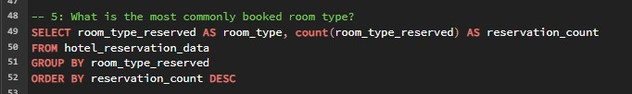
QUESTION 4: How many reservations were made for the year 20XX (replace XX with the desired year)?
QUESTION 5: What is the most commonly booked room type?
In PostgreSQL, to extract each year, we use the extract function.
To get the number of reservations for both years, the year and count of booking_id were selected.
The selection was grouped by year.
room_type_reserved and count of room_type_reserved was selected.
The selection was grouped by room_type_reserved.
The selection was ordered in descending order so that we can see the number of reserved room types from highest to lowest.

Slide 6


QUESTION 6: How many reservations fall on a weekend (no_of_weekend_nights > 0)?
QUESTION 7: What is the highest and lowest lead time for reservations?
Count of booking_id was selected.
The selection was filtered with no_of_weekend_nights > 0
To get the highest and lowest lead time, I made use of the max() and min() aggregate functions

Slide 7
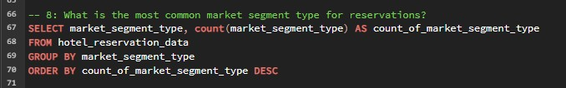

QUESTION 8: What is the most common market segment type for reservations?
QUESTION 9: How many reservations have a booking status of "Confirmed"?
market_segment_type and count of market_segment_type was selected.
The selection was grouped by market_segment_type.
The selection was ordered in descending order so that we can see the number of types of market segment from highest to lowest.
“Confirmed” can also be said to be “Not_Canceled”
Count of booking_id was selected.
The selection was filtered with booking_status equal to Not_Canceled

Slide 8

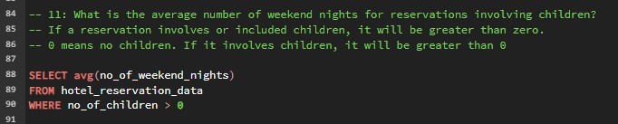
QUESTION 10: What is the total number of adults and children across all reservations?
QUESTION 11: What is the average number of weekend nights for reservations involving children?
To get the total number of adults and children, the sum of the no_of_adults & the no_of_children was selected.
To get the average number of weekend nights for reservations involving children, the average of no_of_weekend_nights column was selected.
The selection was then filtered with no_of_children > 0 to

Slide 9
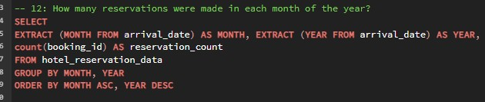
QUESTION 12: How many reservations were made in each month of the year?
To get this, MONTH & YEAR were extracted and selected. Count of booking_id was also selected.
The selection was grouped by the MONTH & YEAR

Slide 10
QUESTION 13: What is the average number of nights (both weekend and weekday) spent by guests for each room type?
To get this, room_type_reserved &the average of no_of_weekend_nights and no_of_week_nights was selected.
The selection was grouped by room_type_reserved.

Slide 11
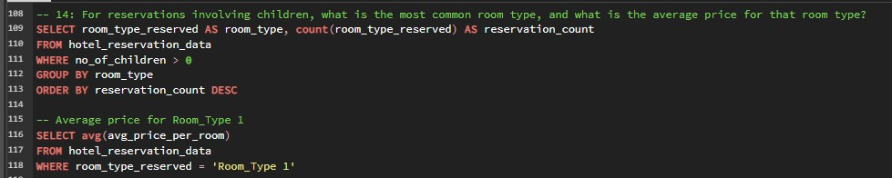
QUESTION 14: For reservations involving children, what is the most common room type, and what is the average price for that room type?
The most common room type for reservations involving children was seen to be Room_Type 1.
To find the average price for that room, the average of avg_price_per_room was selected.
Room_Type 1 was the filtered out using the WHERE clause.
Room_type_reserved and count of room_type_reserved was selected.
The selection was filtered for reservations involving children, was grouped by room type, and ordered in descending order by count of room_type_reserved

Slide 12

QUESTION 15: Find the market segment type that generates the highest average price per room.
To find this, market_segment_type & average of avg_price_per_room were selected.
The selection was grouped by market_segment_type.
It was then ordered by the average of avg_price_per_room descending to arrange the values from highest to lowest.

Slide 13
KEY FINDINGS
The most popular meal plan among guests is Meal Plan 1.
The average price per room for reservations involving children is 144.5
For the year 2017, 123 reservations were made while For the year 2018, 577 reservations were made.
The most commonly booked room type is Room Type 1
383 reservations fall on a weekend.
The highest and lowest lead time for reservations were 433 and 0 respectively.
The online market segment is the most common market segment type for reservations
493 reservations have a booking status of "Confirmed“ or “Not Canceled”.

Slide 14
KEY FINDINGS
Across all reservations, the total number of adults is 1316 and the total number of children is 69.
The average number of weekend nights for reservations involving children is 1.00
For reservations involving children, the most common room type is Room Type 1, and the average price for that room type is 96.9
The market segment type that generates the highest average price per room is the Online market segment type.

